Slide 1
Group Members
Md Hammad Rasheed
Md Amash Shams
Assignment: Capstone_Project
Email Id
mdhammadr@gmail.com
amashshams48@gmail.com
Phone Number
+91 8789322372
+91 9546444762

Slide 2
Dataset: CAR_DETAILS.csv
Objective:
Based on dataset we have to build Machine
Learning model to Predict Selling Price of Car.

Slide 3
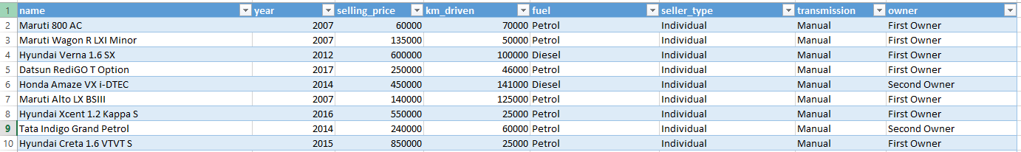
Dataset Preview:

Slide 4
STEP-1:
Analyzing Dataset and there are 8 columns and 4341 rows
Important columns for predicting selling price is based on fuel, seller_type, transmission, owner and Brand.
Extracted Brand column in the dataset using Excel

Slide 5
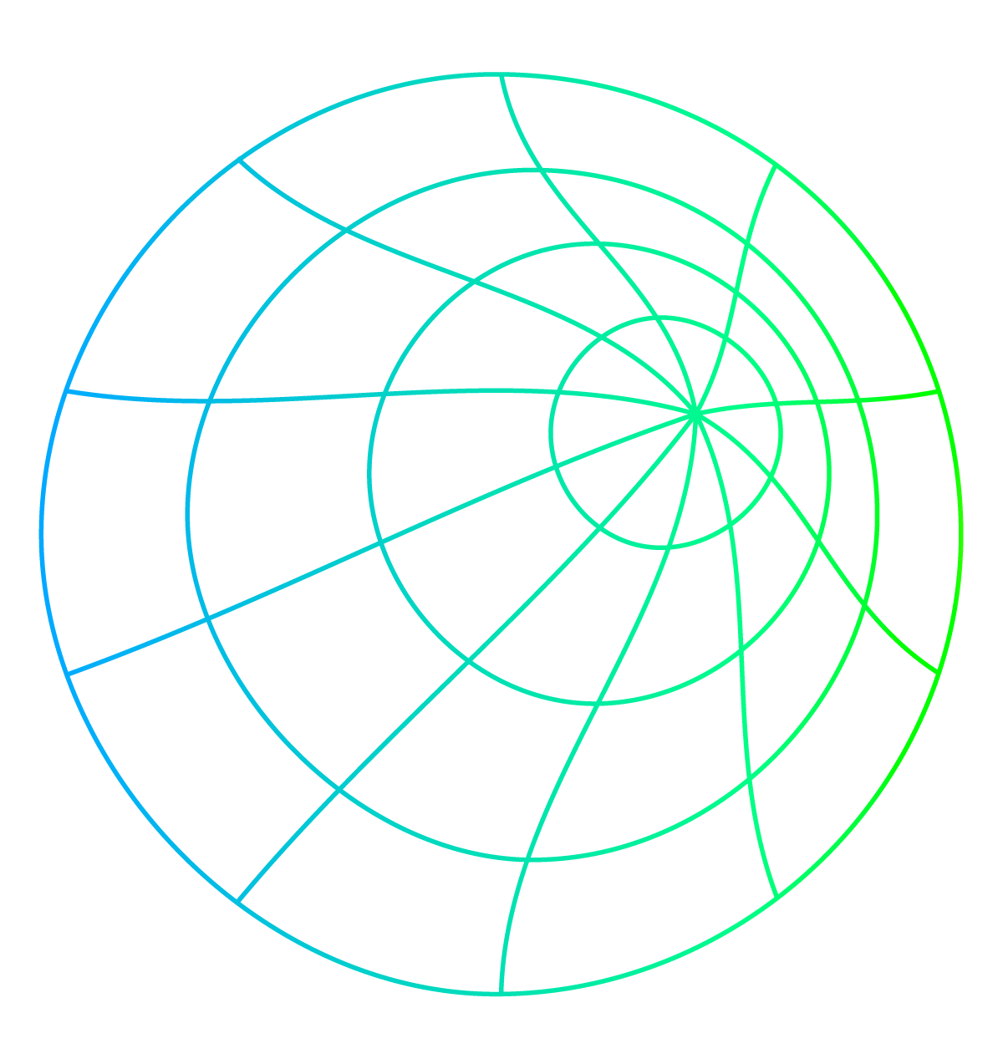
Dataset Preview:
Saved the file in .csv format.
I found that the dataset have Brand is one of the most important part for selling price of
any car model with this number of columns is 9 and number of rows is 4341

Slide 6
Step 2: For selling price prediction , we have 7 most important columns in our dataset.

Slide 7

Brand : Tata, Maruti, Audi, Skoda, Fiat, Honda etc.
Driven (KM)
Year
Transmission : Automatic, Manual.
Seller type : Dealer, Individual, Trustmark Dealer.
Owner type : First Owner, Second Owner, Third Owner, Fourth and Above Owner, Test Drive Car.
Fuel type : Petrol, Diesel, LPG, CNG, Electric.

Slide 8
Step 3: Analyzing the data types of columns of dataset.
Brand : Object
Driven (KM) : Integer
Year : Integer
Transmission : Object
Seller type : Object
Owner type : Object
Fuel type : Object

Slide 9
Step 4: Proceed with python programming.
Libraries (used to build the model):
Pandas
Pandas is a Python library used for working with data sets.
It has functions for analyzing, cleaning, exploring, and manipulating data
NumPy
NumPy is a Python library used for working with arrays.
It also has functions for working in domain of linear algebra, fourier transform, and matrices.
Scikit-learn
Scikit-learn (Sklearn) is the most useful and robust library for machine learning in Python.
It provides a selection of efficient tools for machine learning and statistical modeling
including classification, regression, clustering and dimensionality reduction
via a consistence interface in Python.

Slide 10
Step 4: Continue…
Matplotlib
Matplotlib is a cross-platform, data visualization and graphical plotting library
(histograms, scatter plots, bar charts, etc) for Python and its numerical
extension NumPy. As such, it offers a viable open source alternative to MATLAB.
Seaborn
Seaborn is an amazing visualization library for statistical graphics plotting in Python.
It provides beautiful default styles and color palettes to make
statistical plots more attractive. It is built on top matplotlib
library and is also closely integrated with the data structures from pandas.

Slide 11
Output

Slide 12
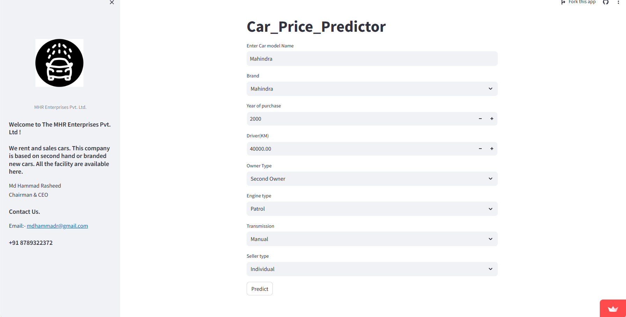

Slide 13
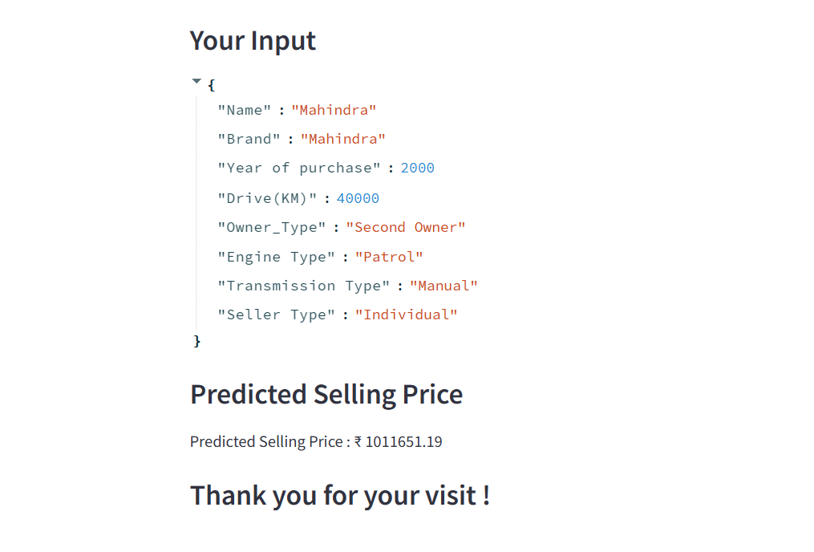

Slide 14


Step 5: Building a Streamlit web app
GitHub Repository Link
Click Here
Streamlit Web App
Click Here

Slide 15



Thank You

